Slide 1
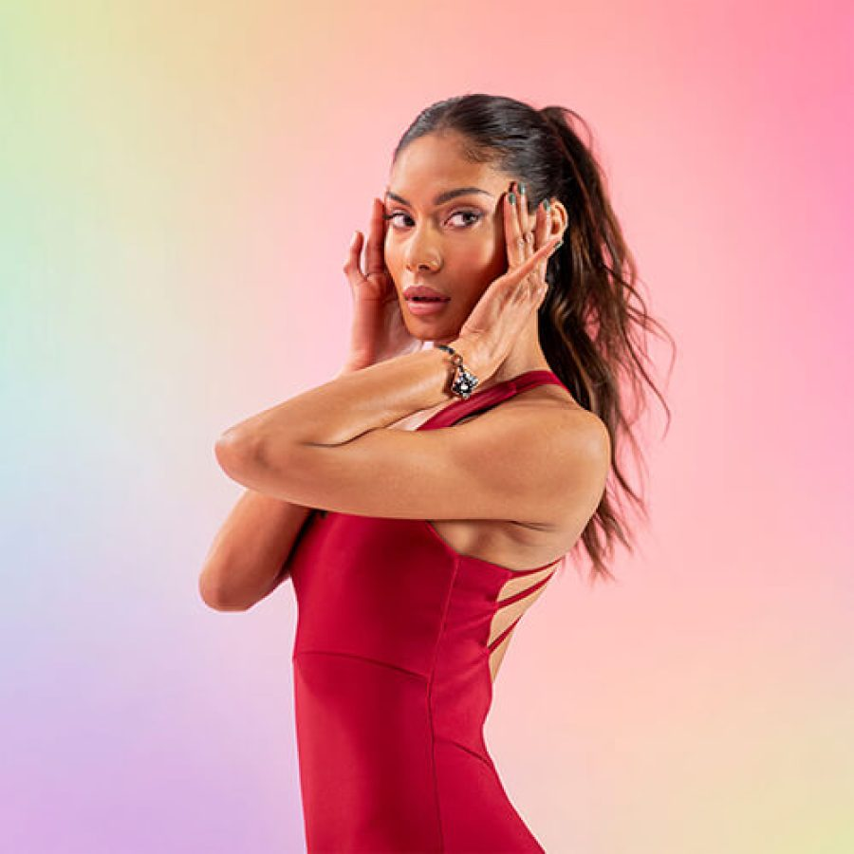
Bellabeat
Case Study #2
January 11, 2023
By: Areg Adamian
Notes:
Line spacing + Page numbers

Slide 2

Agenda
01 Introduction & Business Task
02 Data & Assumptions
03 Data Insights
04 Summary & Recommendations

Slide 3
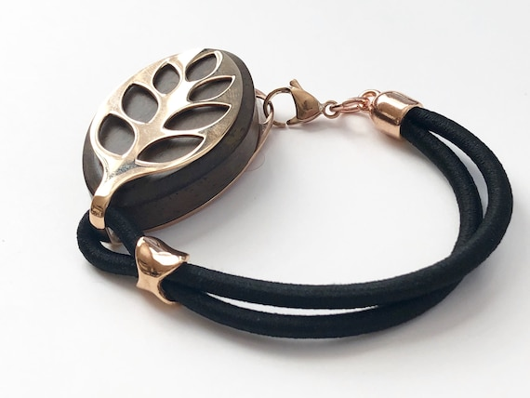
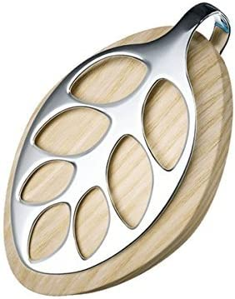
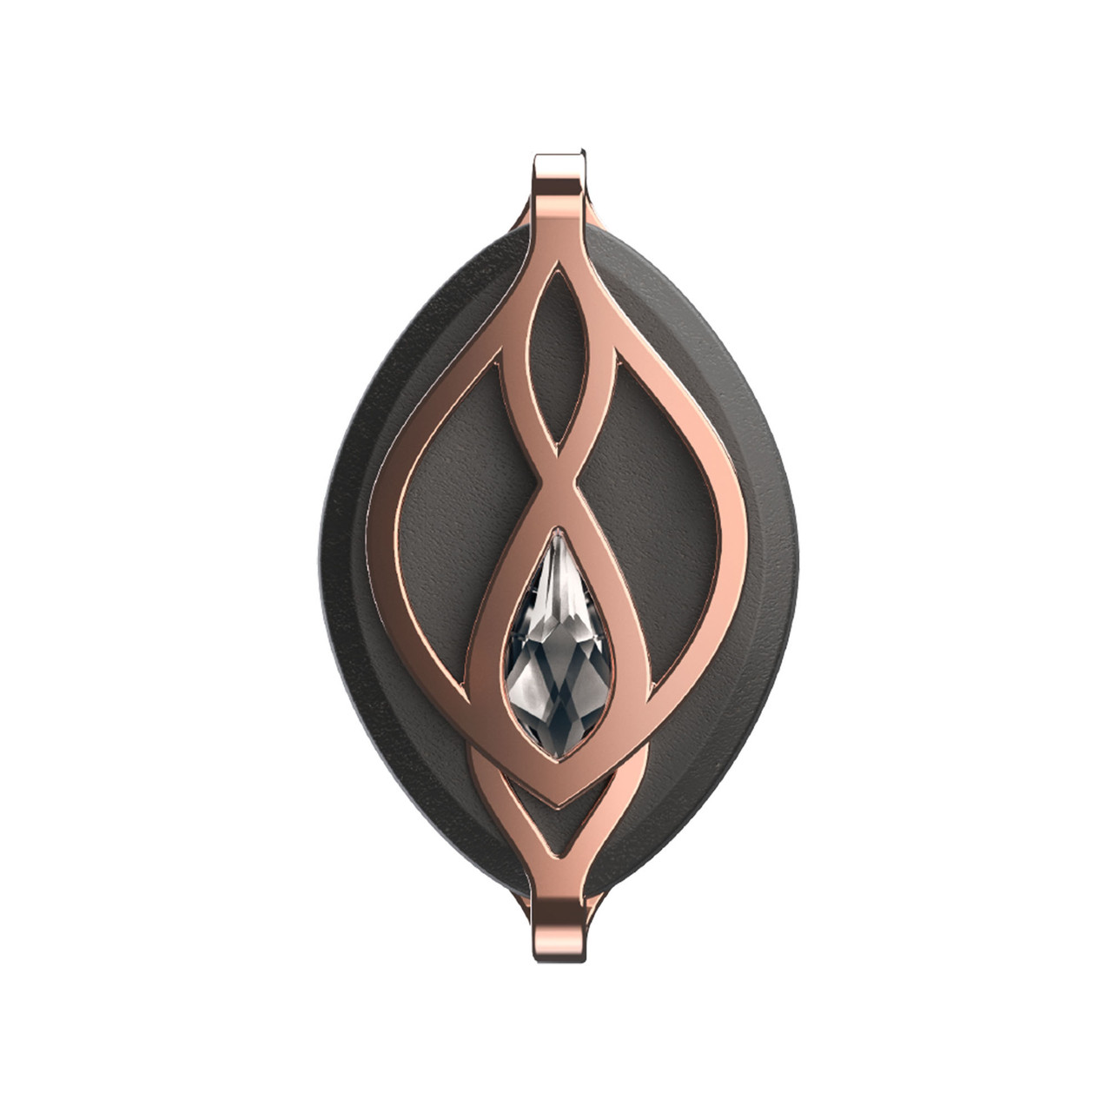
Business Task
01
How do consumers use non-Bellabeat smart devices?
What are some trends in smart device usage?
How could these trends apply to Bellabeat customers?
How could these trends help influence Bellabeat marketing strategy?

Slide 4
Data & Assumptions
02

Slide 5
Data Used
Used FitBit Fitness Tracker Data on Kaggle
Contains information from April 12 – May 12, 2016 on 31 women
Included CDC health classification based on BMI
Removed outliers
> 100 daily steps
4-20 hours of sedentary time a day
>400 calories burned per day

Slide 6
Data Limitations
Didn’t include any minute data due to software limitations
Weight info only for 8 individuals, none that are underweight
Created a bias in the data

Slide 7
Data Insights
03

Slide 8
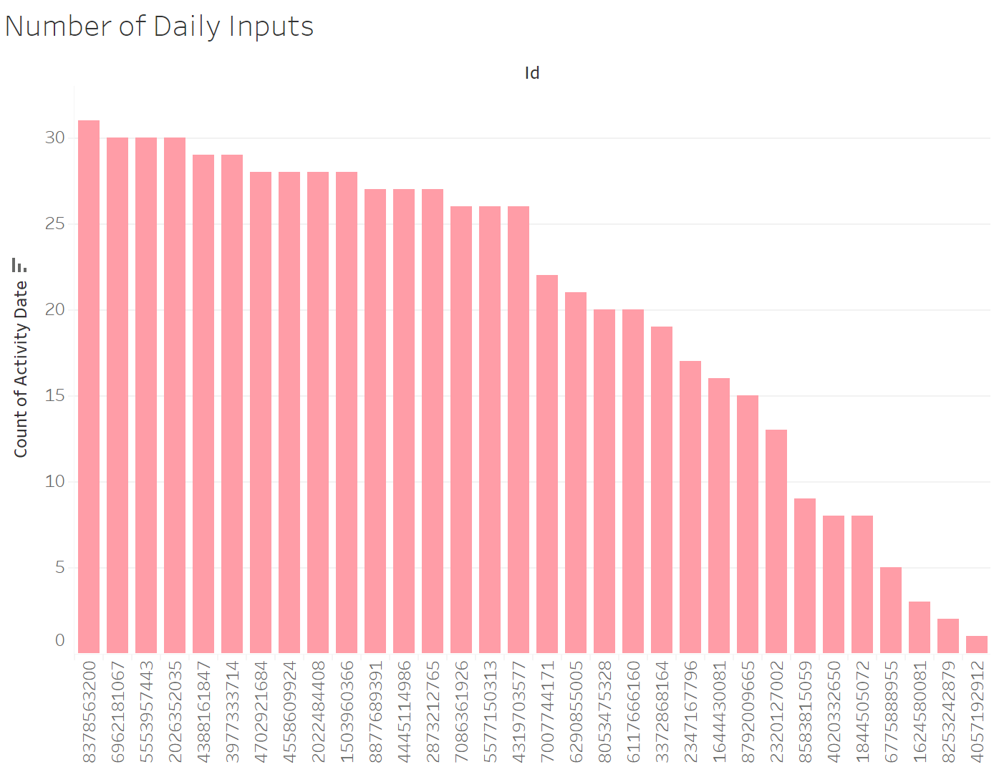
Inputs by Users
About half the users have data for 80% of the days
Users aren’t wearing/using their devices often

Slide 9
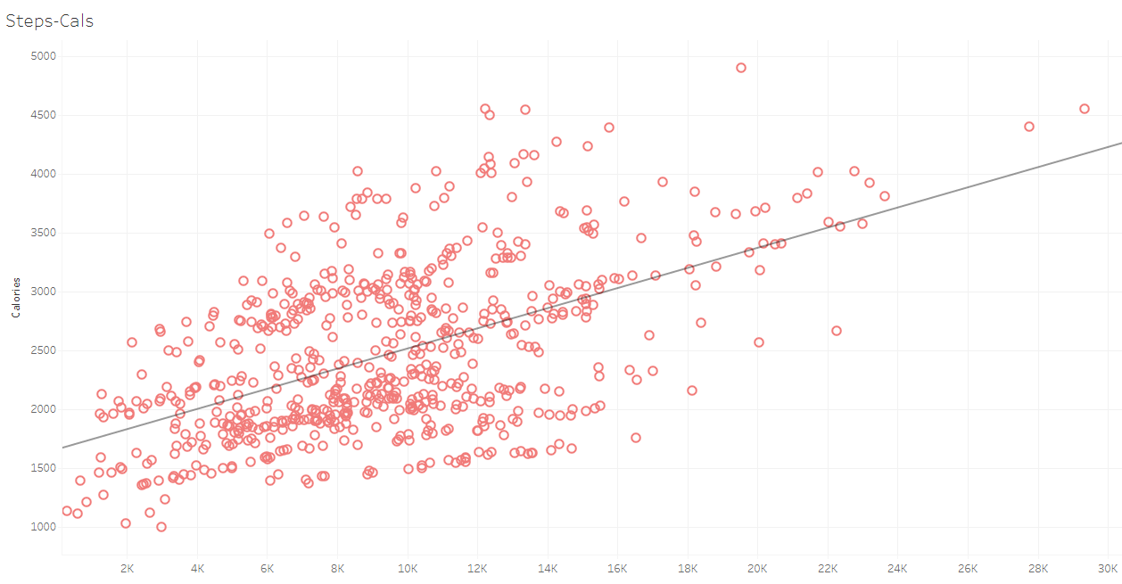
Encourage Movement
More steps = more movement
More movement = more calories burned
Encourage movement for users to use Bellabeat products more

Slide 10
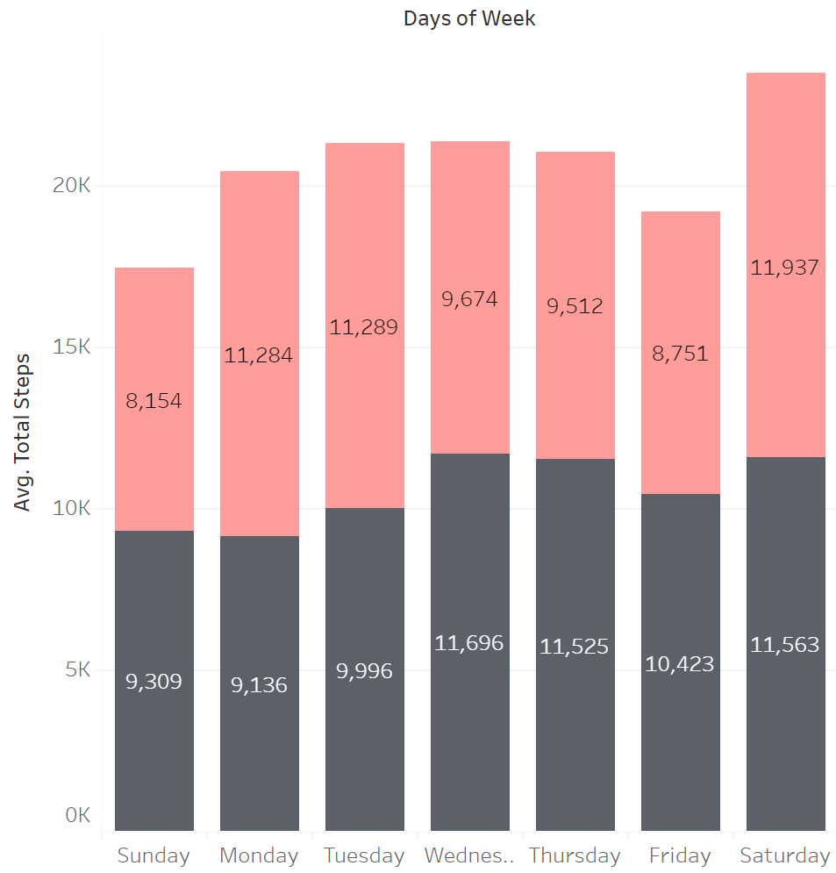
Steps per Day
Most active day is Saturday
Least active day is Sunday
Average between weekdays and weekends are similar

Slide 11
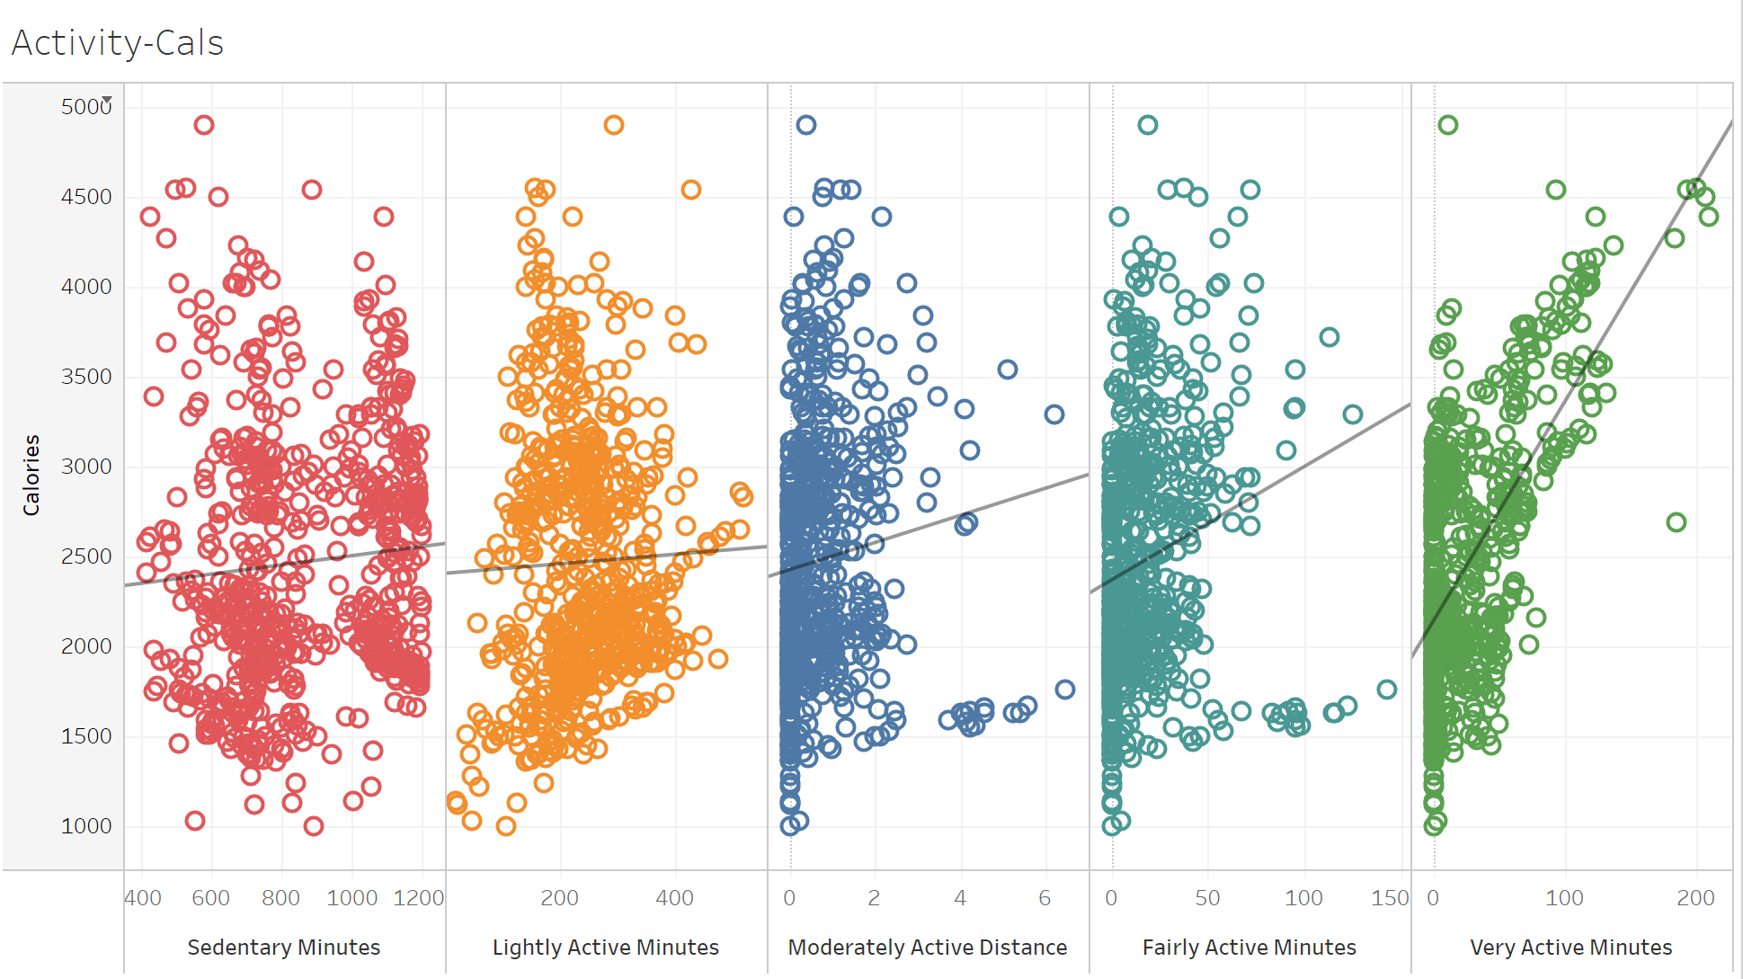
Calories Burned
More active activity leads to more calories burnt
All users have done some light activity
Higher intensity workouts are more effective, but less frequent
Many high sedentary users

Slide 12
Summary & Recommendations
04

Slide 13
Summary
Users don’t always log information on their devices Products aren’t being worn often | High intensity workouts work Users don’t often perform these workouts
Saturday and Sunday are the highest and lowest step days Weekday vs weekend averages are similar | Light workouts are done by all Not as effective, but done much more
More steps = more calories Encourage users to move

Slide 14
Recommendations
Design devices to be worn everyday Provide different customization alternatives Allow connectivity between other Bellabeat (or non-Bellabeat) devices
Use marketing to encourage users to move more Focus marketing on Sundays where users are least active
Create and advertise more workouts tailored to light activities Users tend to perform these activities more often Easier for users to get into being more active than higher intensity workouts
Additional data required for more analysis More user data is needed for better insights More weight and demographic information will also be helpful with marketing

Slide 15
Thank you!

